Slide 1

Diabetes prediction

Slide 2
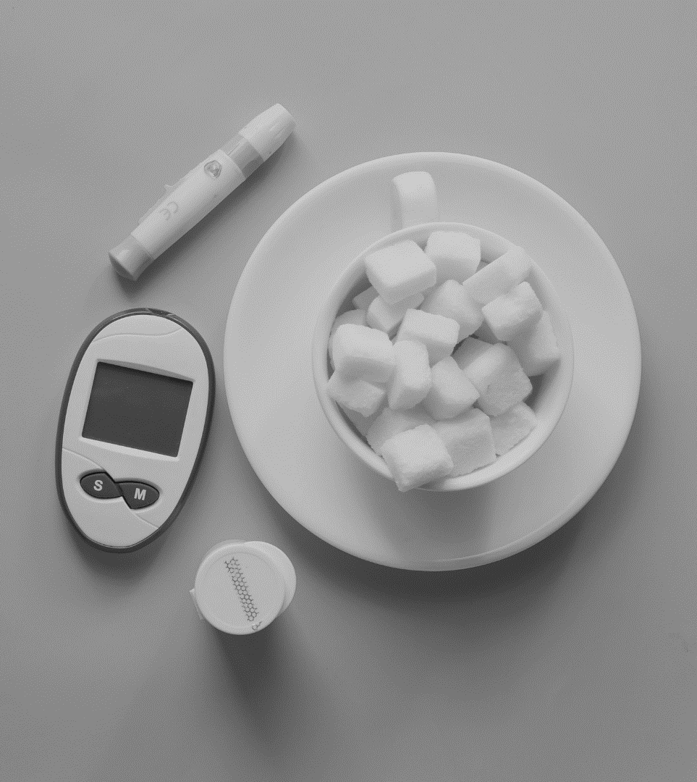
Problem statement
The objective of this project is to build a predictive model for diagnosing diabetes. The model should predict whether a patient has diabetes, prediabetes or does not have diabetes.

Slide 3
Explanatory data analysis
Investing the influence of various health indicators

Slide 4
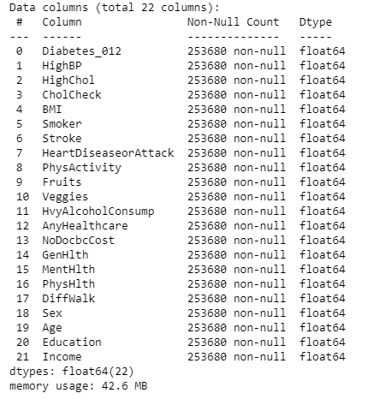
The most important conclusions from EDA
There are no missing value.

Slide 5
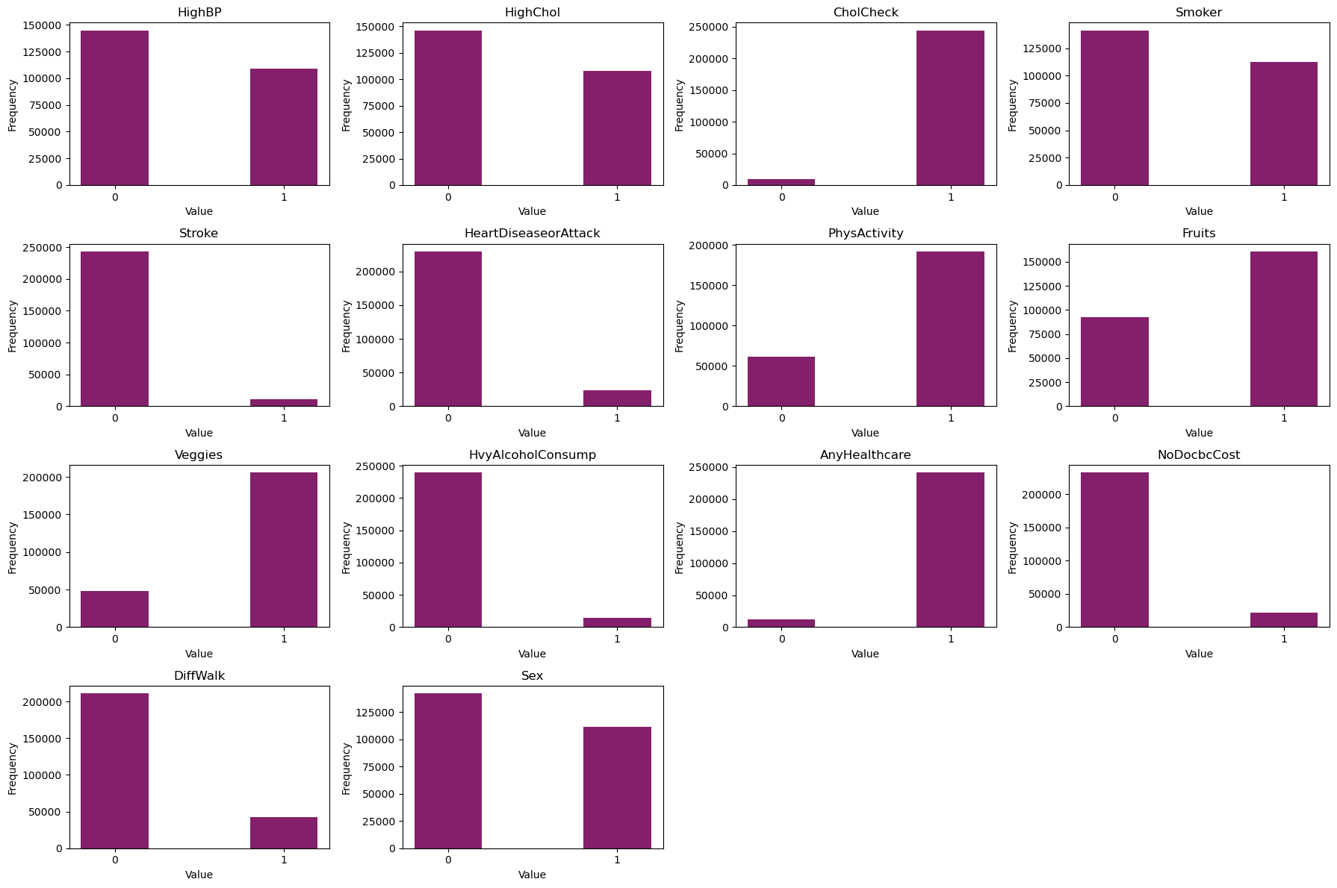
The most important conclusions from EDA
There are no missing value.
The majority of columns are binary.

Slide 6
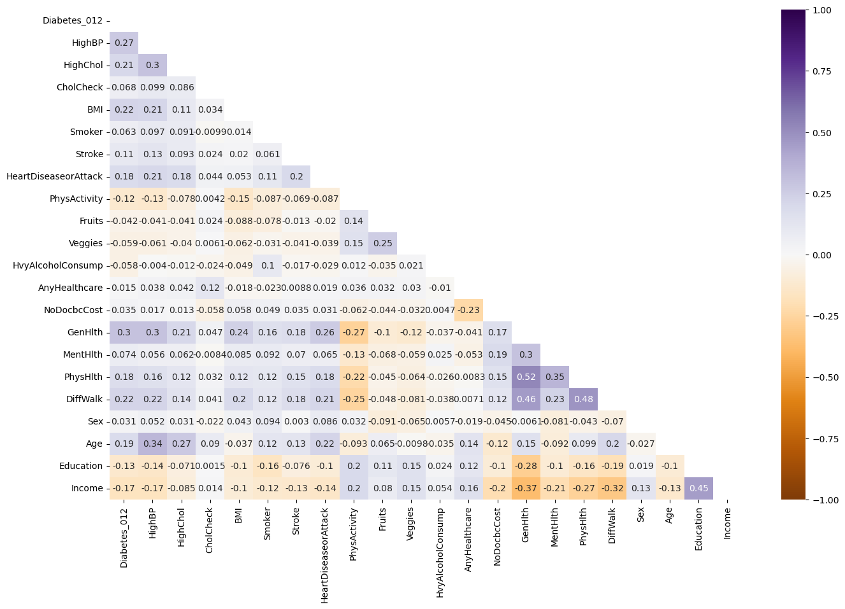
The most important conclusions from EDA
There are no missing value.
The majority of columns are binary.
There are no strongly correlated features.

Slide 7
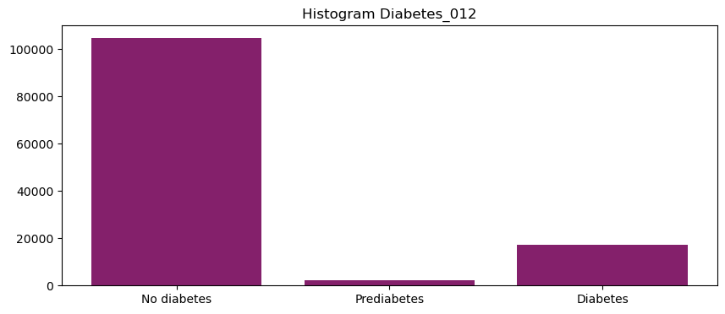
The most important conclusions from EDA
There are no missing value.
The majority of columns are binary.
There are no strongly correlated features.
The target variable is imbalanced.

Slide 8
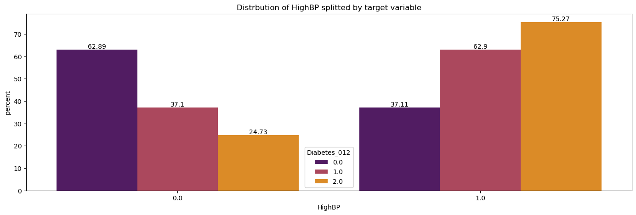
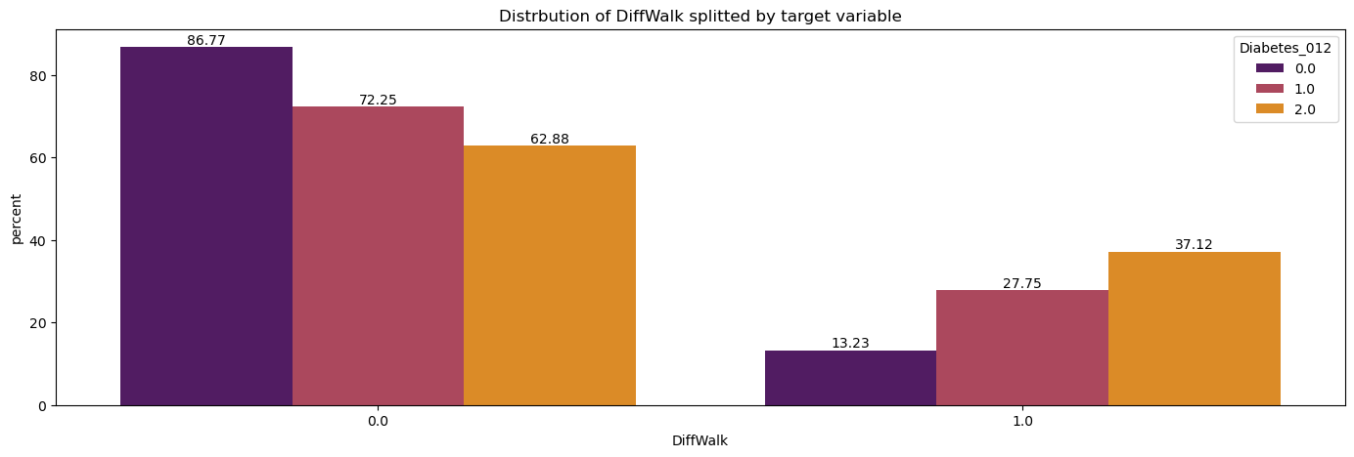
The most important conclusions from EDA
There are no missing value.
The majority of columns are binary.
There are no strongly correlated features.
The target variable is imbalanced.
There is a correlation between some features and the target variable.

Slide 9
Feature engineering
Developing features based on health indicators

Slide 10
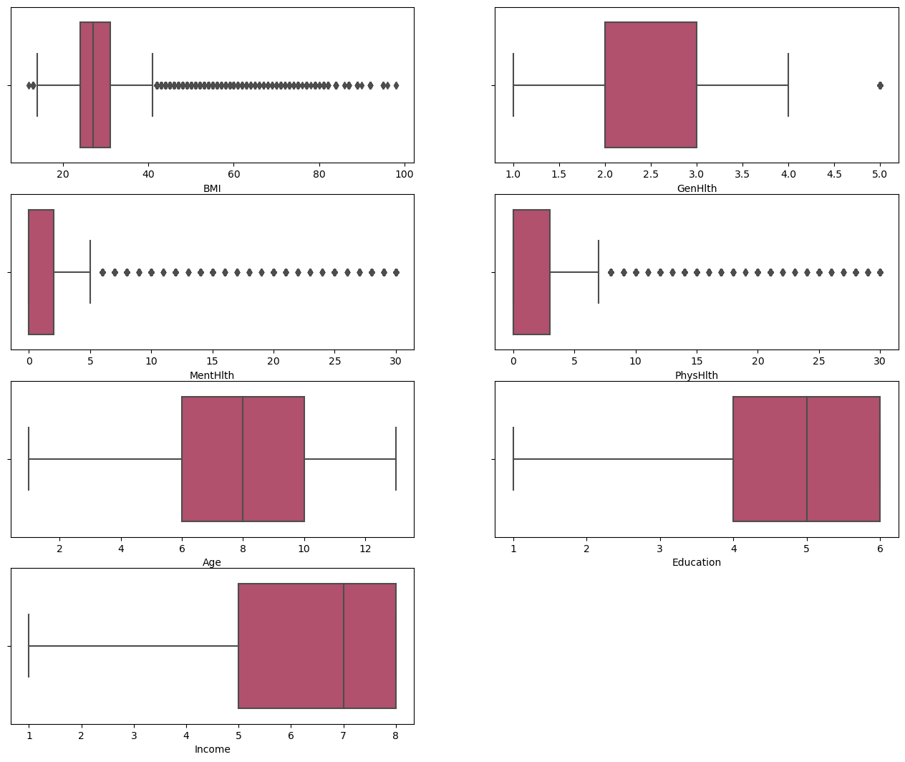
dealing with outliers

Slide 11
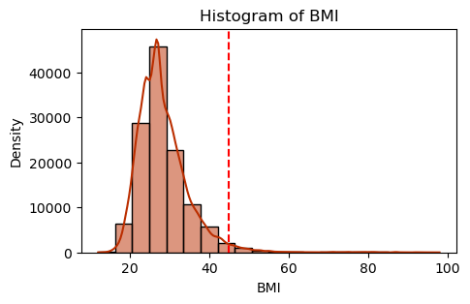
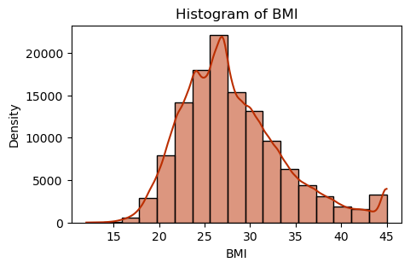
dealing with outliers
We decided to replace 2% of records with the highest BMI value with a value of 45.

Slide 12
dealing with outliers
VALUE | COUNT
1 | 22173
2 | 43721
3 | 37120
4 | 15365
5 | 5924
We have decided not to remove outliers due to the large number of records that take on this value.

Slide 13

CDC
The Centers for Disease Control and Prevention

Slide 14
Feature engineering
NEW FEATURE | DESCRIPTION | PEARSON CORRELATION | SPEARMAN CORRELATION
binned_BMI | BMI feature binned according to CDC guidelines | 0.2070 | 0.2111
OverallHealthStatus | Feature built based on self-assessment attributes of patients | 0.2876 | 0.2709
OverallHealthRisk | Feature constructed based on risk factors for diabetes (strongest correlation with the target variable) | 0.3196 | 0.3135
OverallHealthRisk_CDC | Feature constructed based on risk factors for diabetes according to CDC guidelines | 0.2944 | 0.2919
NutritiousFood | Feature indicating whether a given patient has any access to nutritious food. | -0.0493 | -0.0494
BadHabits | Feature determining whether a given patient has unhealthy habits (alcohol, cigarettes) | -0.0432 | -0.0426

Slide 15
Feature engineering
NEW FEATURE | CODE
binned_BMI
OverallHealthStatus
OverallHealthRisk
OverallHealthRisk_CDC
NutritiousFood
BadHabits
The features that were used to create new features were removed in subsequent steps.

Slide 16
Modeling and validation
Constructing classification models to predict the risk of diabetes and verifying their effectiveness

Slide 17
MODEL | AUC for Class 0 (NoDiabetes) | AUC for Class 1 (PreDiabetes) | AUC for Class 2 (Diabetes)
OneVsRestClassifier SVC | 0.81 | 0.58 | 0.78
Linear Discriminant Analysis (LDA) | 0.82 | 0.69 | 0.82
Quadratic Discriminant Analysis (QDA) | 0.65 | 0.50 | 0.53
K Neighbors Classifier (k-NN) | 0.69 | 0.51 | 0.68
Multinomial Logistic Regression | 0.80 | 0.67 | 0.81
Decision Tree | 0.60 | 0.51 | 0.59
Random Forest | 0.79 | 0.62 | 0.80
Gaussian Naive Bayes¶ | 0.80 | 0.66 | 0.80
Gradient Boosting for classification | 0.82 | 0.68 | 0.83
AdaBoost classifier | 0.82 | 0.66 | 0.83
XGBoost | 0.82 | 0.68 | 0.83
Multi-layer Perceptron classifier | 0.82 | 0.69 | 0.83

Slide 18
MODEL | AUC for Class 0 (NoDiabetes) | AUC for Class 1 (PreDiabetes) | AUC for Class 2 (Diabetes)
OneVsRestClassifier SVC | 0.81 | 0.58 | 0.78
Linear Discriminant Analysis (LDA) | 0.82 | 0.69 | 0.82
Quadratic Discriminant Analysis (QDA) | 0.65 | 0.50 | 0.53
K Neighbors Classifier (k-NN) | 0.69 | 0.51 | 0.68
Multinomial Logistic Regression | 0.80 | 0.67 | 0.81
Decision Tree | 0.60 | 0.51 | 0.59
Random Forest | 0.79 | 0.62 | 0.80
Gaussian Naive Bayes¶ | 0.80 | 0.66 | 0.80
Gradient Boosting for classification | 0.82 | 0.68 | 0.83
AdaBoost classifier | 0.82 | 0.66 | 0.83
XGBoost | 0.82 | 0.68 | 0.83
Multi-layer Perceptron classifier | 0.82 | 0.69 | 0.83

Slide 19
MODEL | AUC for Class 0 (NoDiabetes) | AUC for Class 1 (PreDiabetes) | AUC for Class 2 (Diabetes)
OneVsRestClassifier SVC | 0.81 | 0.58 | 0.78
Linear Discriminant Analysis (LDA) | 0.82 | 0.69 | 0.82
Quadratic Discriminant Analysis (QDA) | 0.65 | 0.50 | 0.53
K Neighbors Classifier (k-NN) | 0.69 | 0.51 | 0.68
Multinomial Logistic Regression | 0.80 | 0.67 | 0.81
Decision Tree | 0.60 | 0.51 | 0.59
Random Forest | 0.79 | 0.62 | 0.80
Gaussian Naive Bayes¶ | 0.80 | 0.66 | 0.80
Gradient Boosting for classification | 0.82 | 0.68 | 0.83
AdaBoost classifier | 0.82 | 0.66 | 0.83
XGBoost | 0.82 | 0.68 | 0.83
Multi-layer Perceptron classifier | 0.82 | 0.69 | 0.83

Slide 20
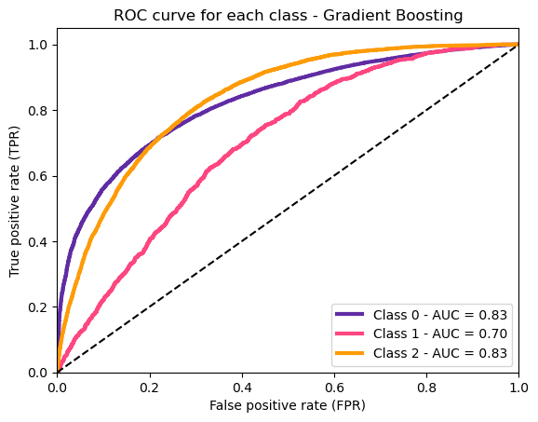
Gradient Boosting for classification
Best parameters: {'n_estimators': 200, 'min_samples_leaf': 1, 'max_depth': 3, 'learning_rate': 0.05}
roc_auc_ovr before tuning | 0.7814
roc_auc_ovr after tuning | 0.7848

Slide 21
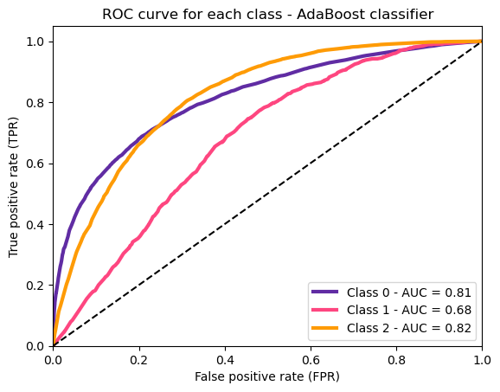
AdaBoost classifier
Best parameters: {'estimator': DecisionTreeClassifier(criterion='entropy', max_depth=1), 'n_estimators': 25}
roc_auc_ovr before tuning | 0.7678
roc_auc_ovr after tuning | 0.7723

Slide 22
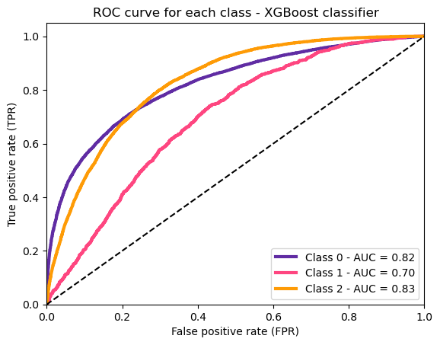
XGBoost
Best parameters: {'learning_rate': 0.1, 'max_depth’: 2, 'n_estimators': 200}
roc_auc_ovr before tuning | 0.7741
roc_auc_ovr after tuning | 0.7839

Slide 23

Multi-layer Perceptron classifier
Best parameters: {'solver': ‚lbfgs', 'learning_rate': ‚constant', 'hidden_layer_sizes': (100, 3), 'early_stopping': False, 'alpha': 0.1, 'activation': 'logistic'}
roc_auc_ovr before tuning | 0.7786
roc_auc_ovr after tuning | 0.7796

Slide 24
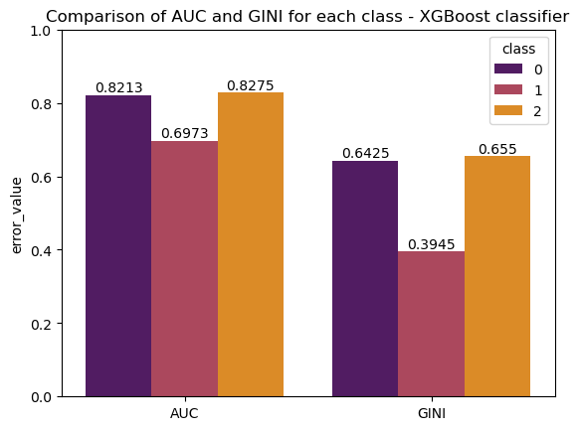
OUR FINAL MODEL XGBOOST
The model was selected due to the highest AUC value for the diabetes class, indicating that it will detect the highest number of patients with diabetes, which was our main goal.

Slide 25
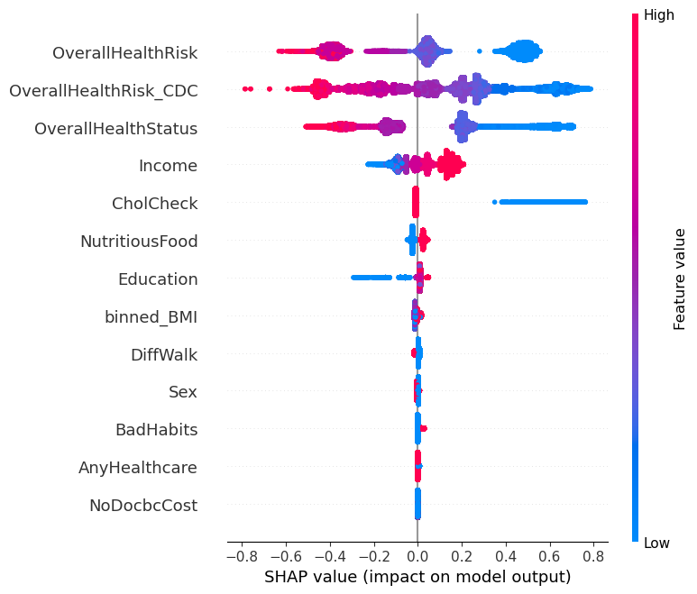
Summary plot
For NO diabetes prediction

Slide 26
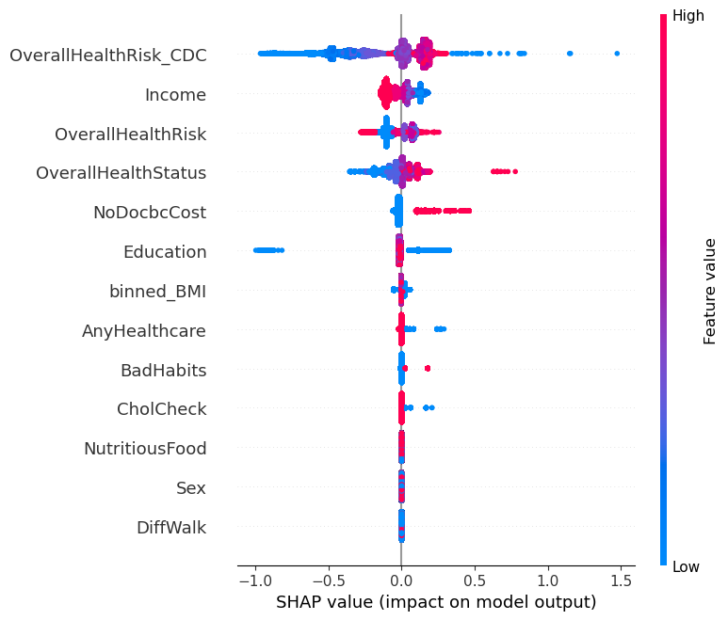
Summary plot
For PREdiabetes prediction

Slide 27
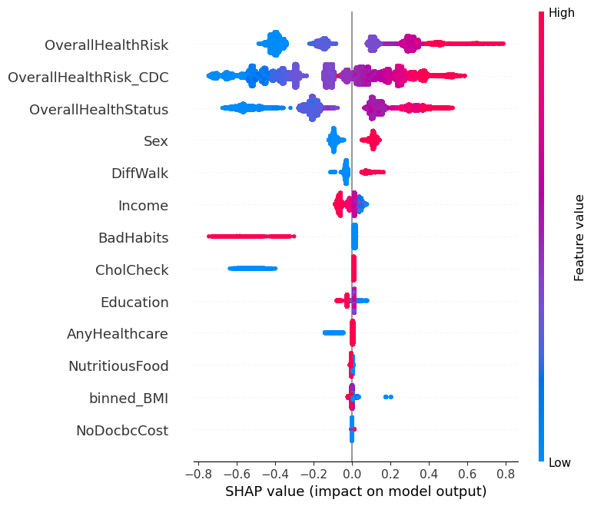
Summary plot
For diabetes prediction

Slide 28
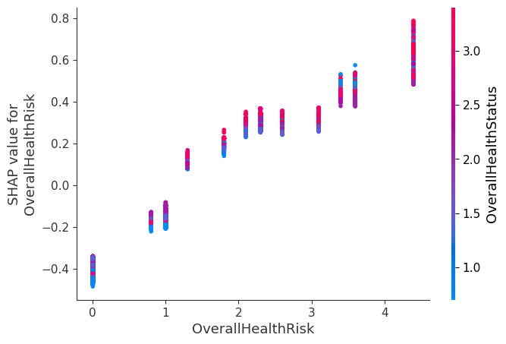
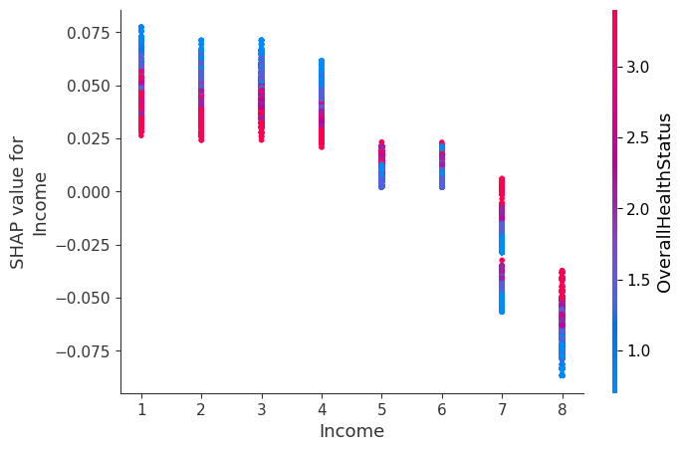
Closer look on diabetes prediction

Slide 29
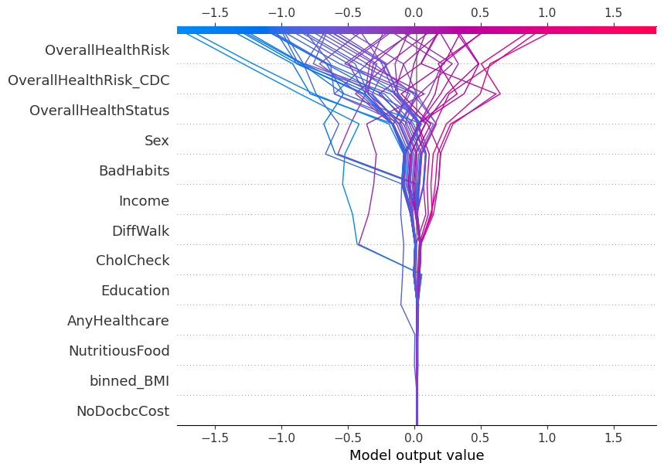
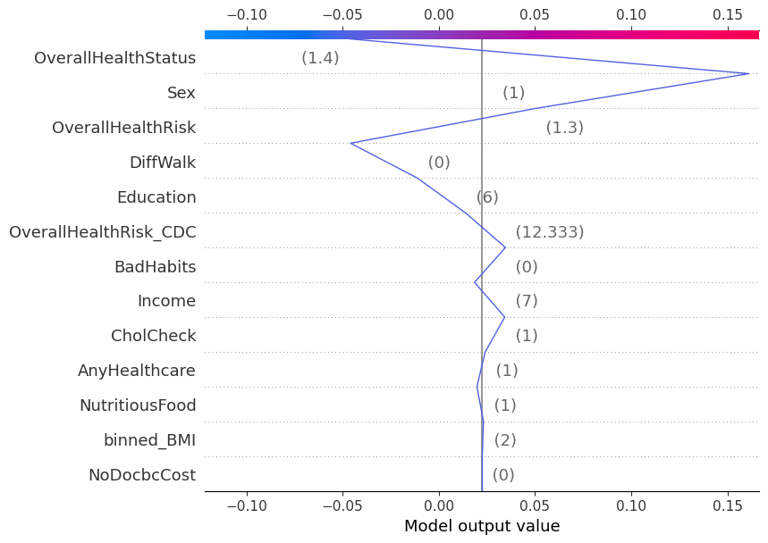
Closer look on diabetes prediction

Slide 30
Validation team
Throughout our project, Michał Pytel and Paweł Pozorski provided essential support as part of our validation team. They confirmed the accuracy of our analyses and results and provided valuable input on our model construction. Thanks to their efforts, we have full confidence in the effectiveness of our model.

Slide 31
THANK YOU
Authors:
Bogumiła Okrojek
Aleksandra Kwiatkowska

